Slide 1
Technical Review:
Bias Correction for Paid Search in MMM

Slide 2
Bias Correction for Paid Search in MMM
Research Question and Methodologies
Regression 101
Regression and Its Underlying Assumptions
Biased Estimate of Paid Search due to Omitted Variables
Regression: From Linearity to Non-Linearity
Generalized Additive Model (GAM)
Paid Search Bias Correction (SBC)
Case Studies: Major Findings and Limitations
SBC vs Altice MMM: Replications and Gaps
What’s Next

Slide 3
Research Question and Methodologies
Research Question
How to estimate the causal effect of paid search on sales in the context of Media Mix Modeling(MMM)
Methodologies
The back-door criterion from the causal inference literature
Randomized controlled trial (RCT)
Generalized additive models (GAM)

Slide 4

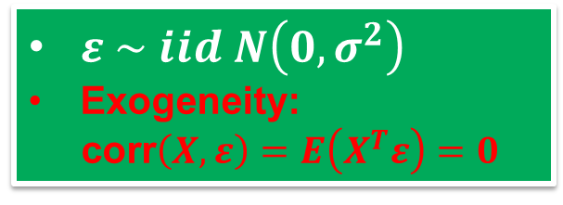

Regression: Model Specification and Key Assumptions*
General Relationship
$y=f\left(X,β\right)$ + $ε$
Linear Regression
$$y=Xβ+ε$$
Key Assumptions*
$ε \sim iid N\left(0,σ^{2}\right)$
Exogeneity:
corr$\left(X, ε\right)=E\left(X^{T}ε\right)=0$
* See the below links for more information:
https://en.wikipedia.org/wiki/Linear_regression
https://en.wikipedia.org/wiki/Ordinary_least_squares#Assumptions
https://en.wikipedia.org/wiki/Endogeneity_(econometrics)
https://en.wikipedia.org/wiki/Omitted-variable_bias

Slide 5

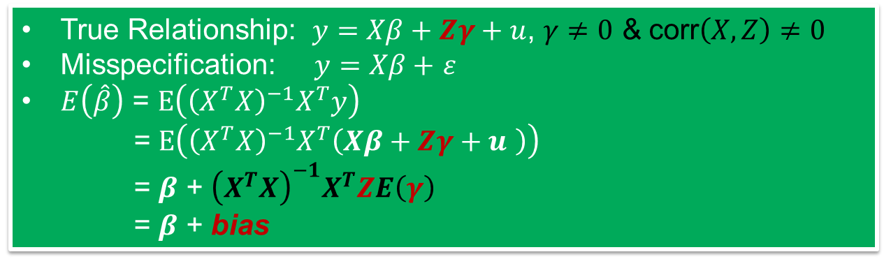

Regression: Biased Estimate of Paid Search
OLS
$$\hat{β}={\left(X^{T}X\right)}^{−1}X^{T}y$$
Biased Estimator
$$E\left(\hat{β}\right)≠β$$
Omitted Variables (Z)
True Relationship: $y=Xβ+Zγ+u$, $γ≠0$ & corr$\left(X, Z\right)$ $≠0$
Misspecification: $y=Xβ+$ $ε$
$E\left(\hat{β}\right)$ = $E\left({\left(X^{T}X\right)}^{−1}X^{T}y\right)$
= $E\left({\left(X^{T}X\right)}^{−1}X^{T}\left(Xβ+Zγ+u \right)\right)$
= $β$ + ${\left(X^{T}X\right)}^{−1}X^{T}ZE\left(γ\right)$
$\text{=}$ $β$ + bias
Why the impact of Paid Search on Sales is over-estimated?
Selection bias from ad targeting (Z) is not properly incorporated in Media Mix Model.
Paid Search (X) is positively correlated with Z.

Slide 6
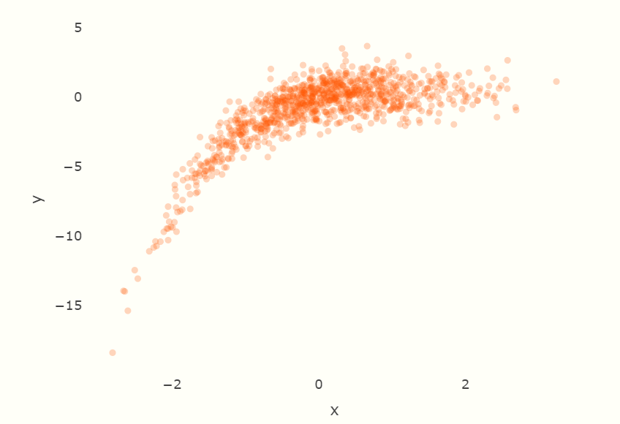
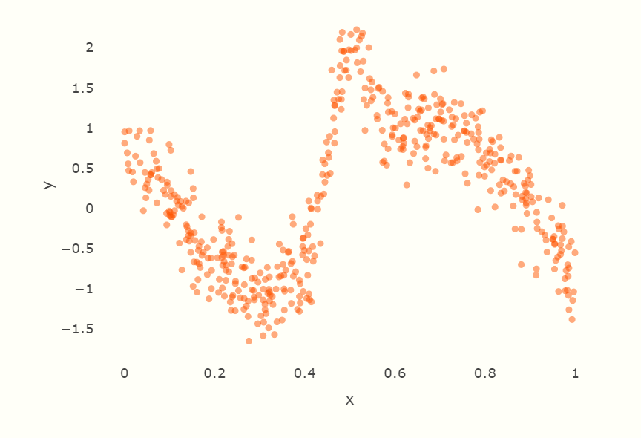
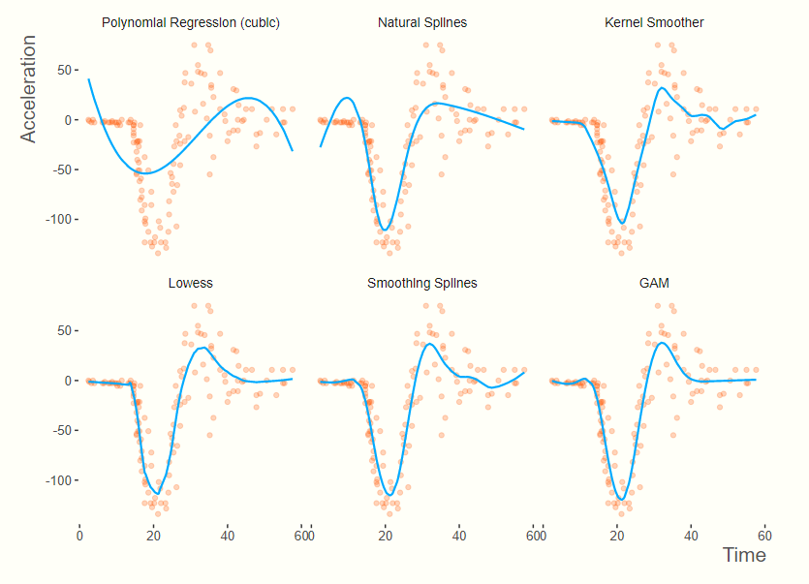
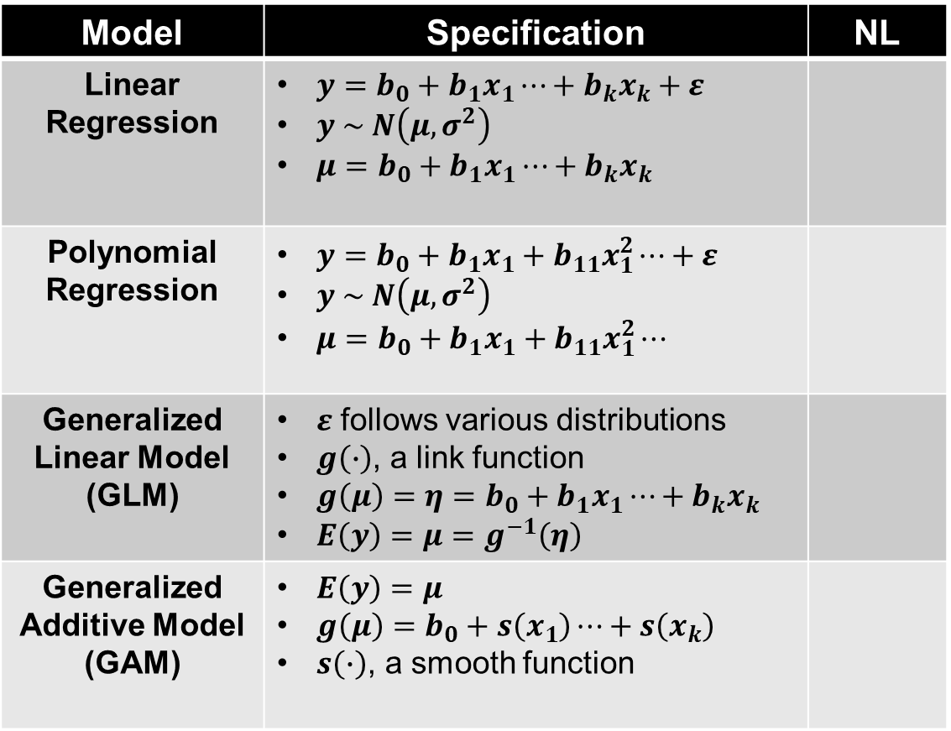
Regression: From Linearity to Non-Linearity (NL)*
Model | Specification | NL
Linear Regression | $y=b_{0}+b_{1}x_{1}⋯+b_{k}x_{k}+ε$ $y \sim N\left(μ,σ^{2}\right)$ $μ=b_{0}+b_{1}x_{1}⋯+b_{k}x_{k}$
Polynomial Regression | $y=b_{0}+b_{1}x_{1}+b_{11}x_{1}^{2}⋯+ε$ $y \sim N\left(μ,σ^{2}\right)$ $μ=b_{0}+b_{1}x_{1}+b_{11}x_{1}^{2}⋯$
Generalized Linear Model (GLM) | $ε$ follows various distributions $g\left(∙\right)$, a link function $g\left(μ\right)=η=b_{0}+b_{1}x_{1}⋯+b_{k}x_{k}$ $E\left(y\right)=μ=g^{−1}\left(η\right)$
Generalized Additive Model (GAM) | $E\left(y\right)=μ$ $g\left(μ\right)=b_{0}+s\left(x_{1}\right)⋯+s\left(x_{k}\right)$ $s\left(∙\right)$, a smooth function
*Source:
https://m-clark.github.io/generalized-additive-models/introduction.html

Slide 7
SBC: Causal Diagram for Paid Search*
Causal Diagram → the Standard MMM
Confounders → Search Query, etc.
Functional Form, p(y|X, Z) → GAM
* Source: https://arxiv.org/abs/1807.03292

Slide 8
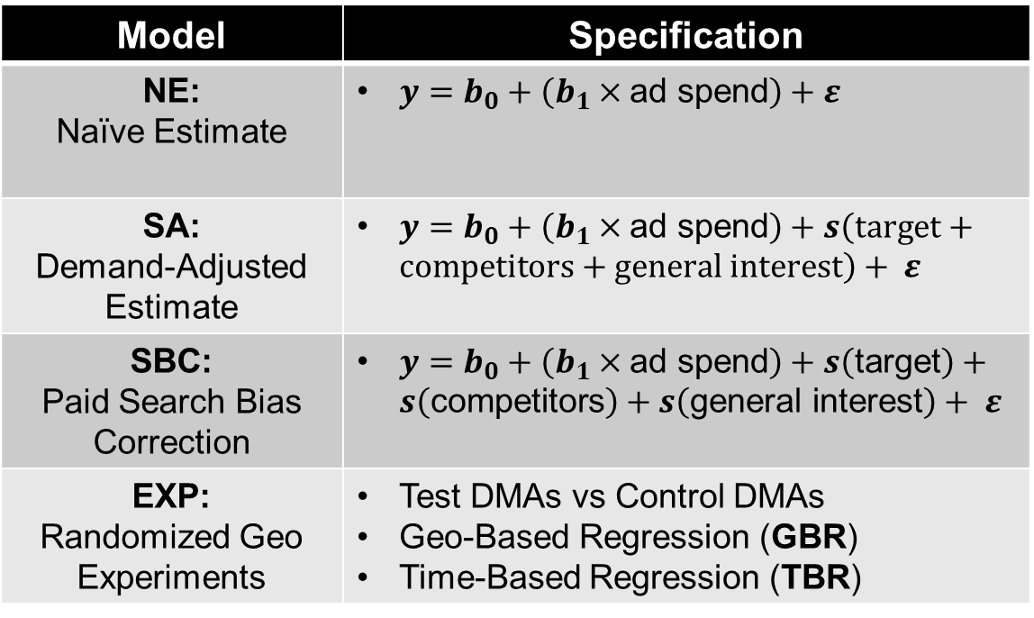
SBC: Model Specification* and Case Studies 1 – 3
Model | Specification
NE: Naïve Estimate | $y=b_{0}+\left(b_{1}×\text{ad} \text{spend}\right)+ε$
SA: Demand-Adjusted Estimate | $y=b_{0}+\left(b_{1}×\text{ad} \text{spend}\right)+s\left(\text{target}\text{ + }\text{competitors}\text{ + }\text{general} \text{interest}\right)+ ε$
SBC: Paid Search Bias Correction | $y=b_{0}+\left(b_{1}×\text{ad} \text{spend}\right)+s\left(\text{target}\right)+s\left(\text{competitors}\right)+s\left(\text{general} \text{interest}\right)+ ε$
EXP: Randomized Geo Experiments | Test DMAs vs Control DMAs Geo-Based Regression (GBR) Time-Based Regression (TBR)
65 days
135 days
88 days
Note the following empirical findings:
corr(sales, ad spend) & corr(sales, target) are very high.
Strong linearities are observed in the scatter plots.
corr(sales, ad spend) < corr(sales, target).
corr(ad spend, target) are very high.
* Source: https://arxiv.org/abs/1807.03292

Slide 9
SBC: Case Study 4 without Randomized Experiment Result*
* Source: https://arxiv.org/abs/1807.03292

Slide 10
SBC: Replication and Gaps
Criteria | SBC | Altice MMM
Model Specification | Simple linear regression with generalized additive terms | Mixed regression with nonlinearly transformed media variables
Estimation | Penalized maximum likelihood estimation Can use Bayesian estimation. | Bayesian estimation in STAN Can’t use frequentist estimation due to model complexities.
Media Variables | Paid Search is the only/primary channel. | Multiple channels
Control Variables | No | Yes
Carryover Effect | No | Yes
Shape Effect | No | Yes
Heterogeneity | No | Yes by DMA
Is GAM Necessary? | Yes, due to high correlation between ad spend and search query | Not really; correlation is much lower Don forget that GMA is developed to capture nonlinear relationship between y and X.
Paid Search Bias Correction (SBC) | Estimate the unbiased effect of Paid Search first with the SBC applied (see 4.3.). Use the estimated effect of Paid Search as the fixed values in the full MMM. Calibrate the effect of other media channels. | Is the suggested SBC approach compatible with Altice MMM? Model specifications Estimation methods GAM

Slide 11
What Is Next?
Use SBC or Not.
Utilize GAM or not.
Adjust MMM specifications.
A model for Paid Search
Full MMM
Apply Different Estimation Methods.
Contingent on the usage of GAM

